Slide 1
High-level Architecture UML Diagrams
1. High Level Architecture
2. Class Diagrams for Static View
3. Sequence Diagrams for Dynamic View
4. Archived Diagrams

Slide 2
1. High Level Architecture: Abstract Backend Architecture
Core : Pure business logic without any external dependencies
Infra : Implementation of the components required by the interfaces
* Note that the following dependency graph is structured as a directed acyclic graph (DAG).
core
infra
repository
interfaces
model
others
services
controller

Slide 3
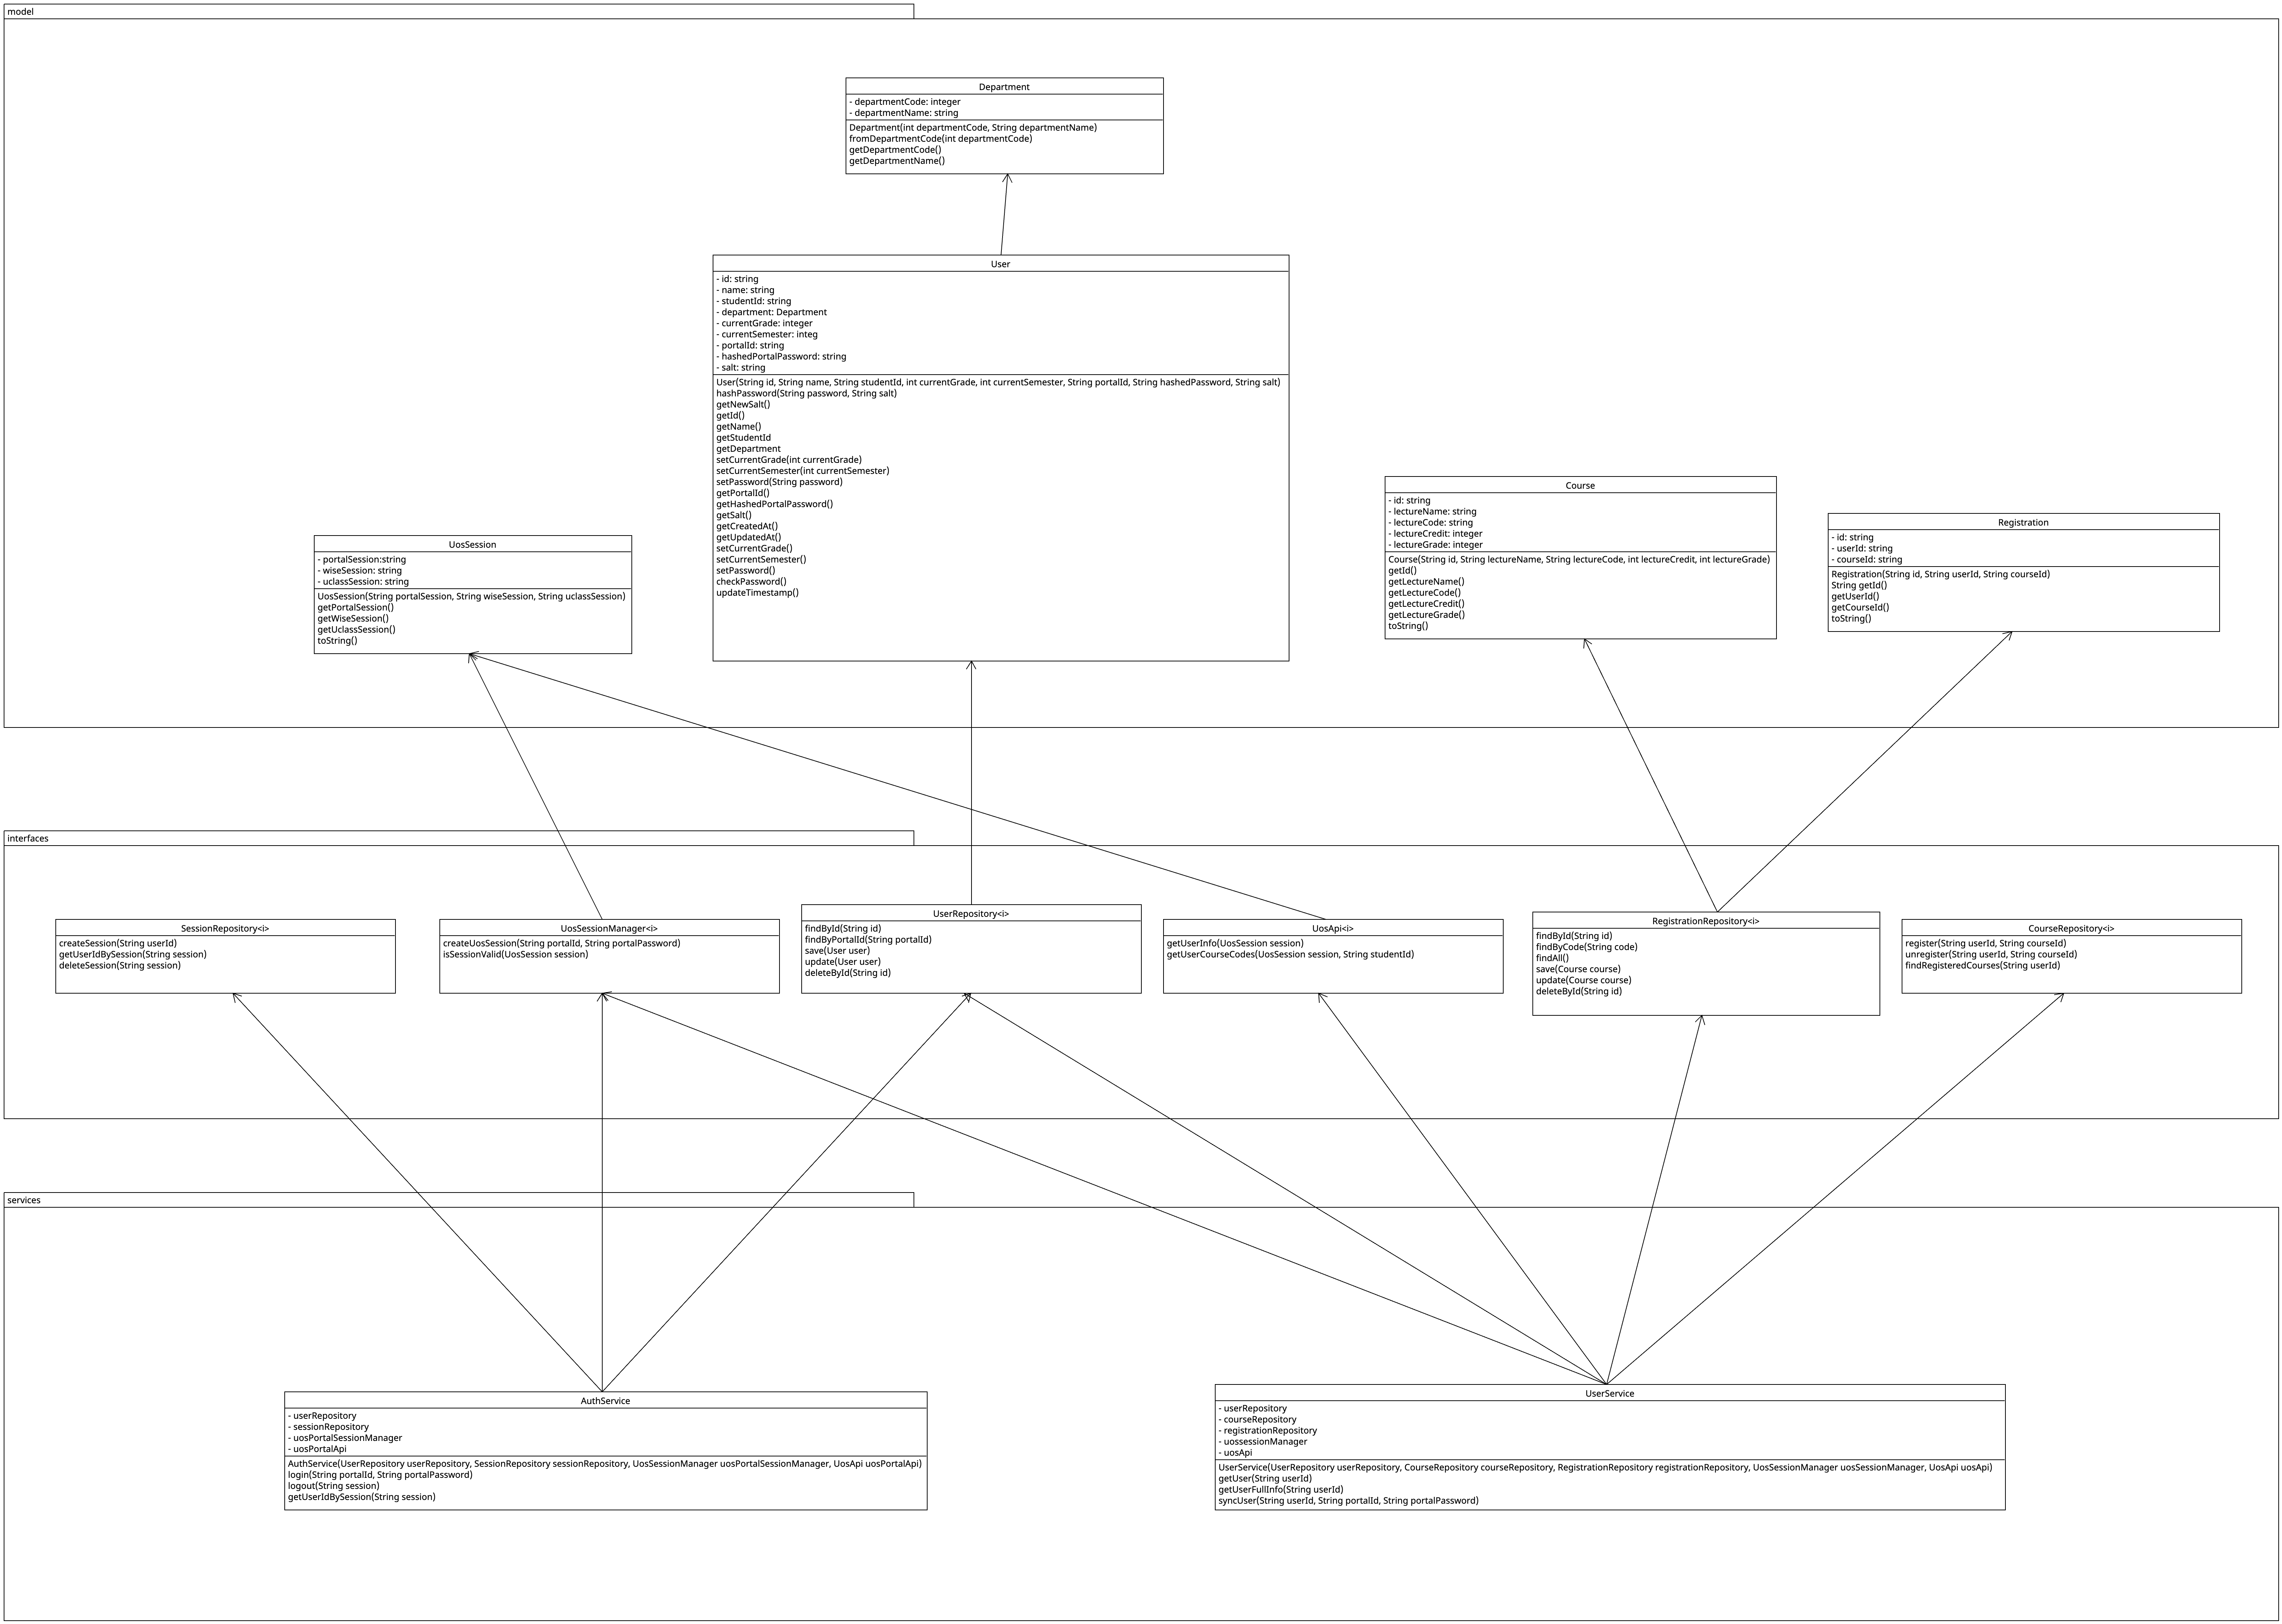
2. Class Diagram for Static View

Slide 4
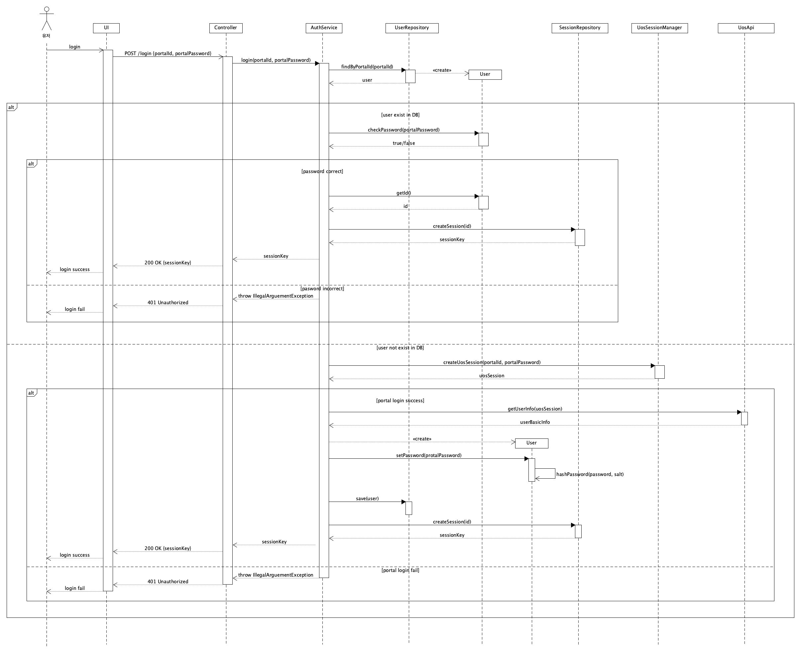
3. Sequence Diagram: UC001
Use case ID: UC001

Slide 5
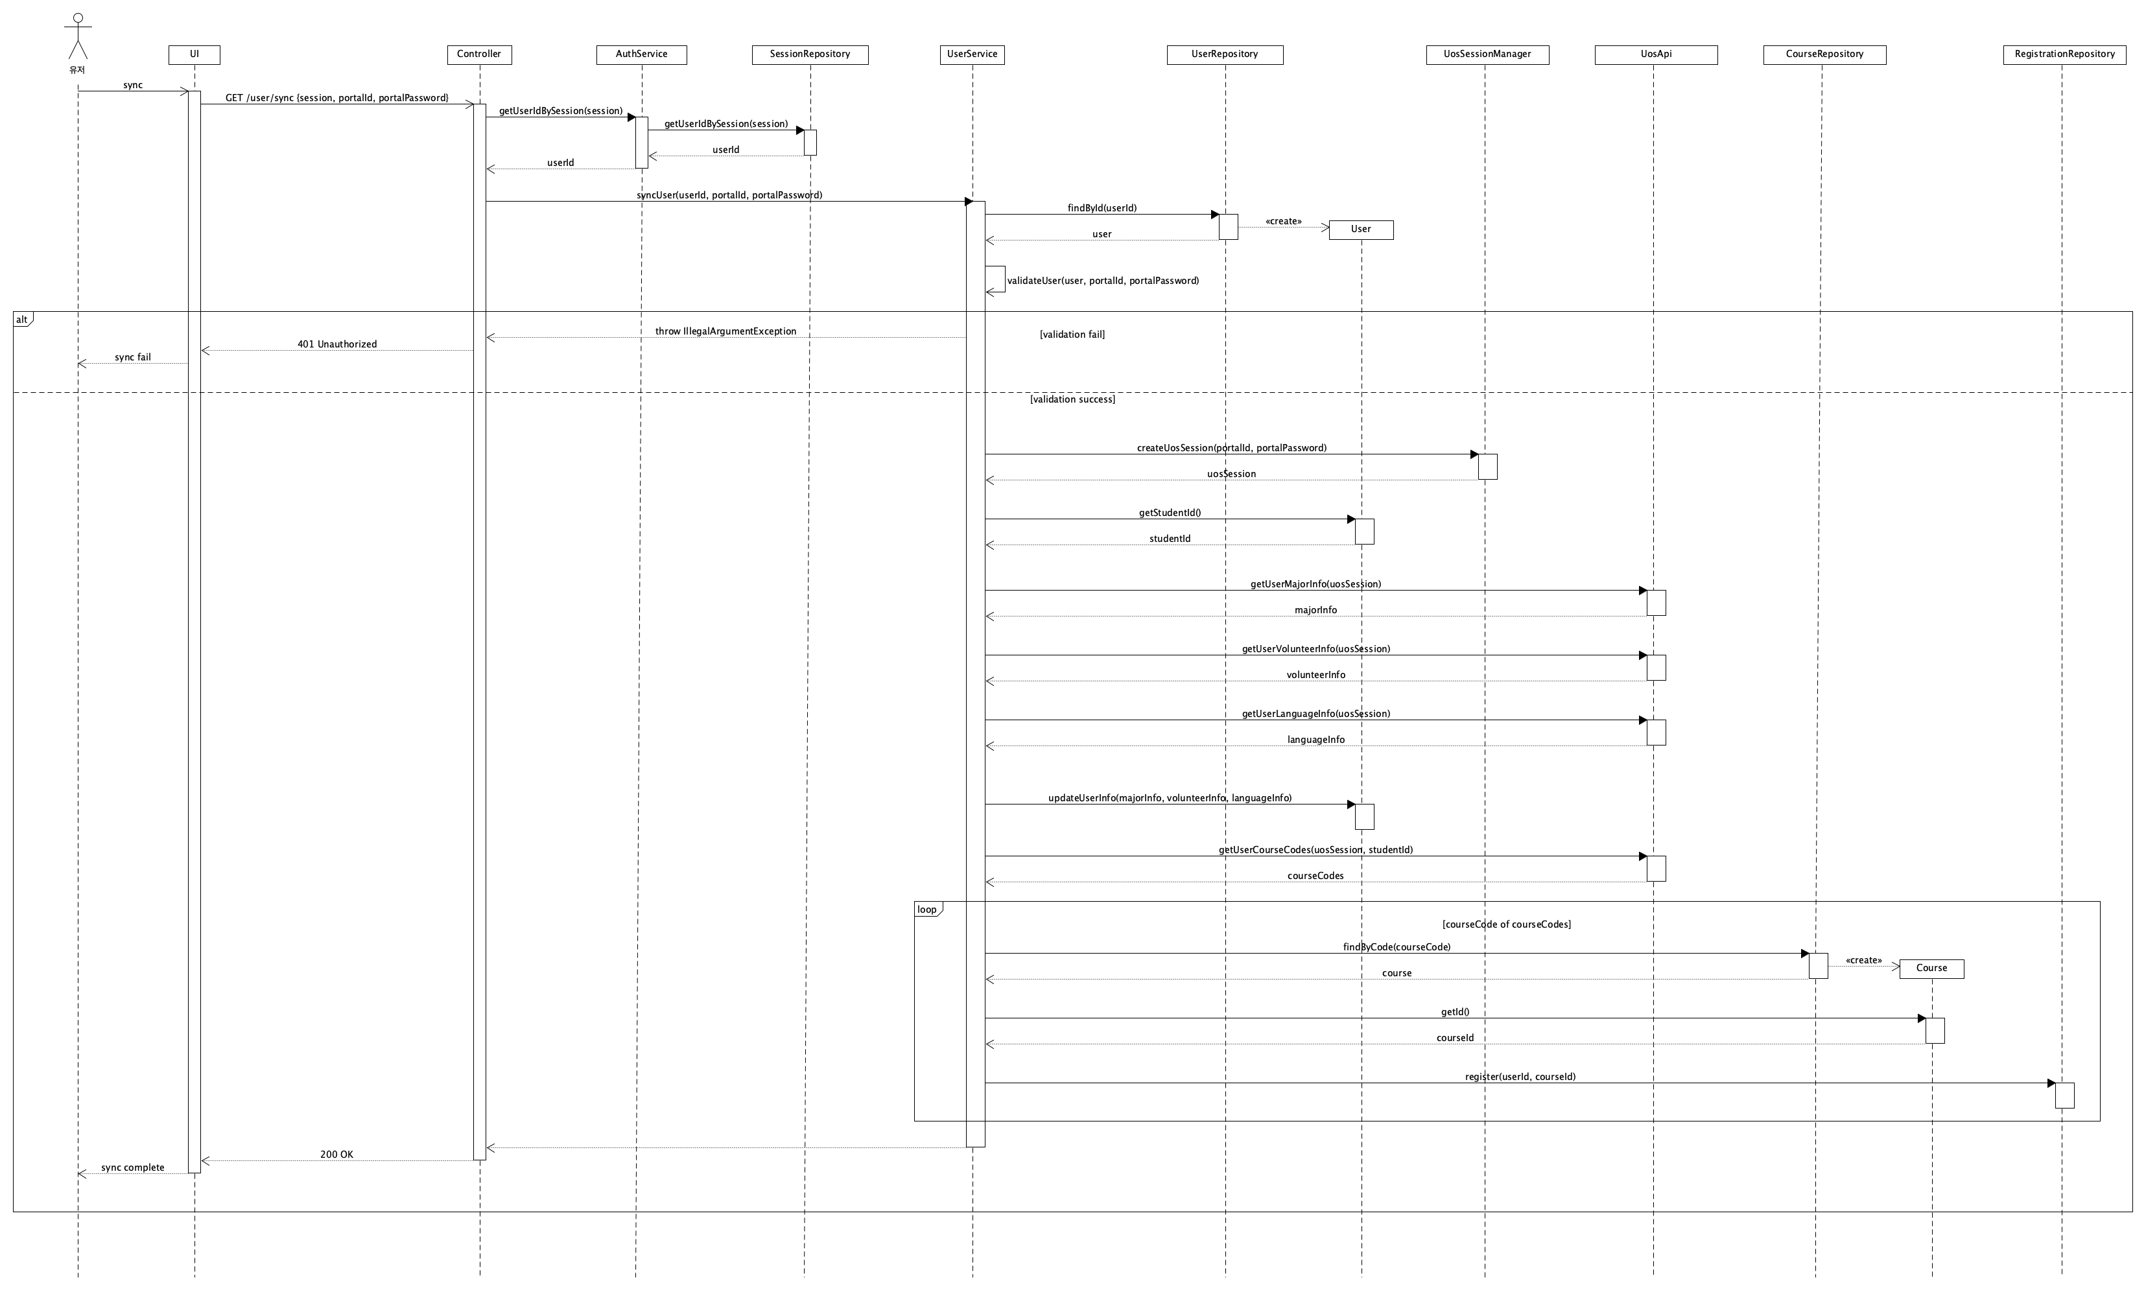
3. Sequence Diagram: UC002
Use case ID: UC002

Slide 6
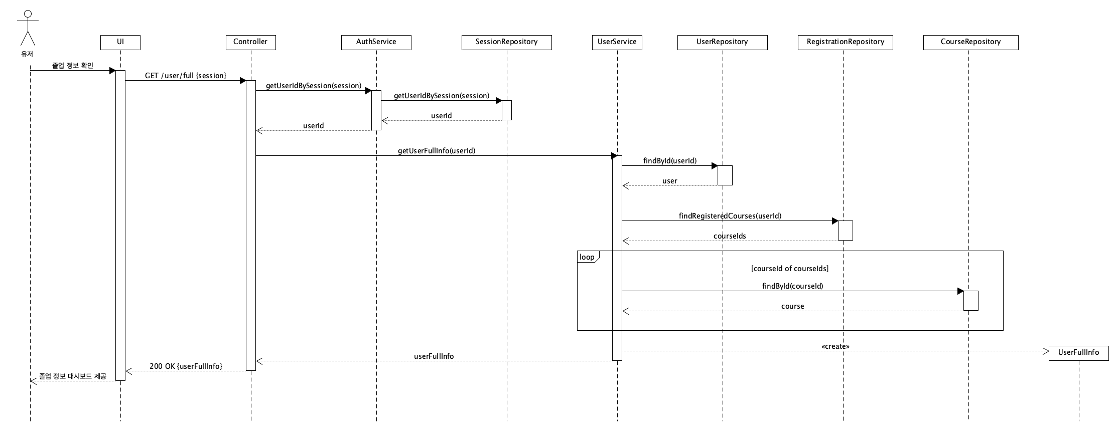
3. Sequence Diagram: UC003
Use case ID: UC003

Slide 7
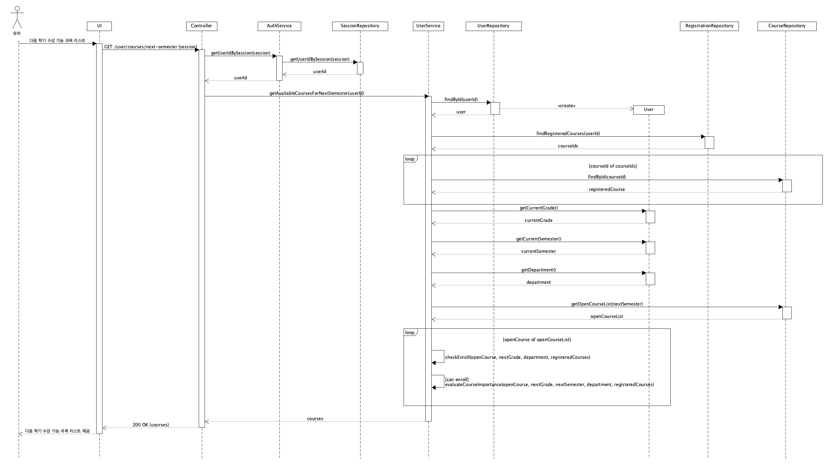
3. Sequence Diagram: UC004
Use case ID: UC004

Slide 8
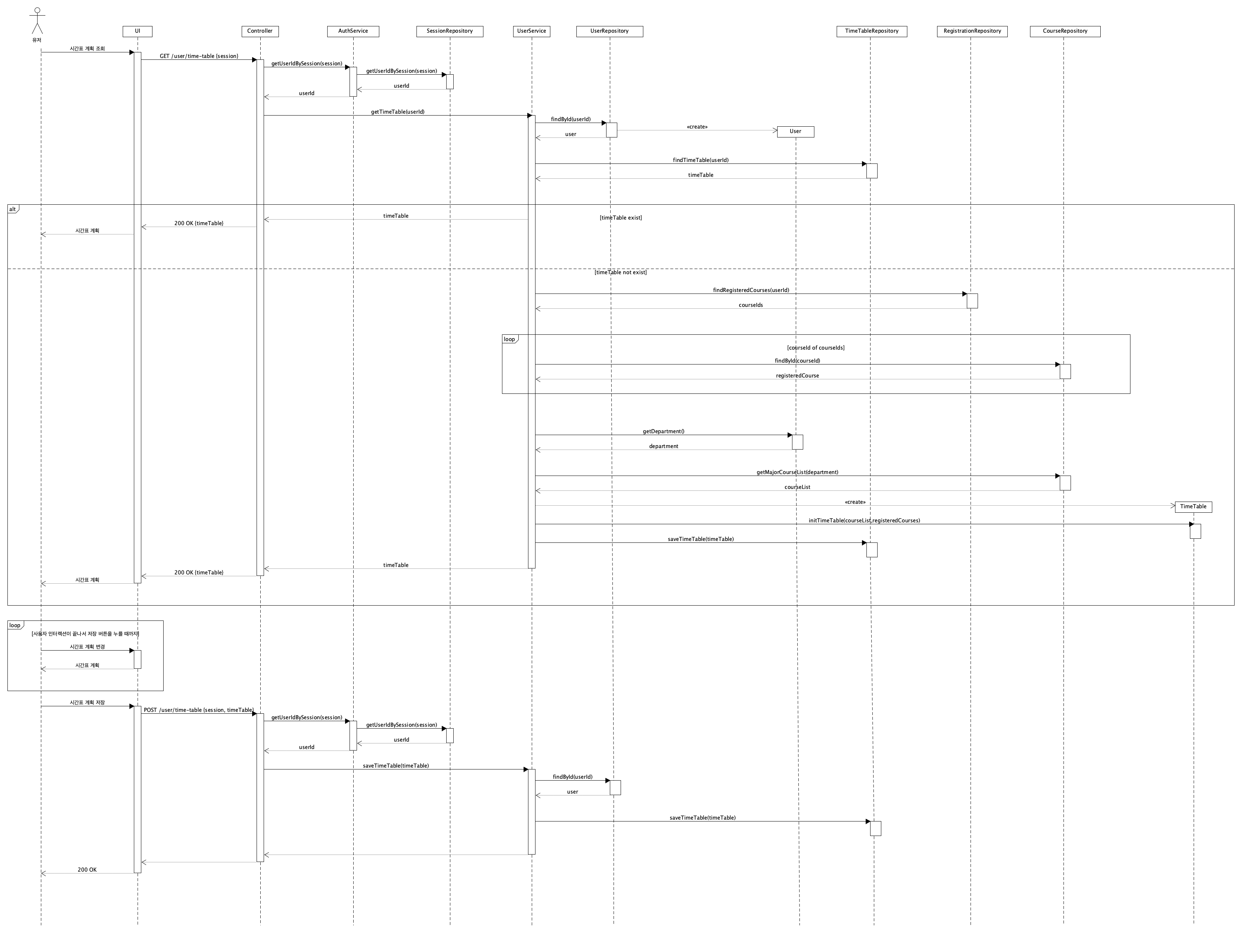
3. Sequence Diagram: UC005
Use case ID: UC005

Slide 9
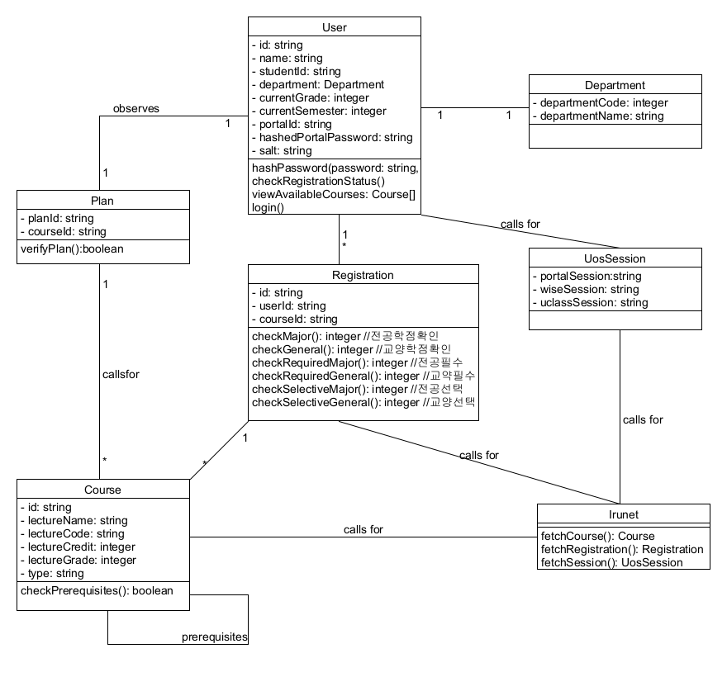
4. Archived Diagram: Class Diagram

Slide 10
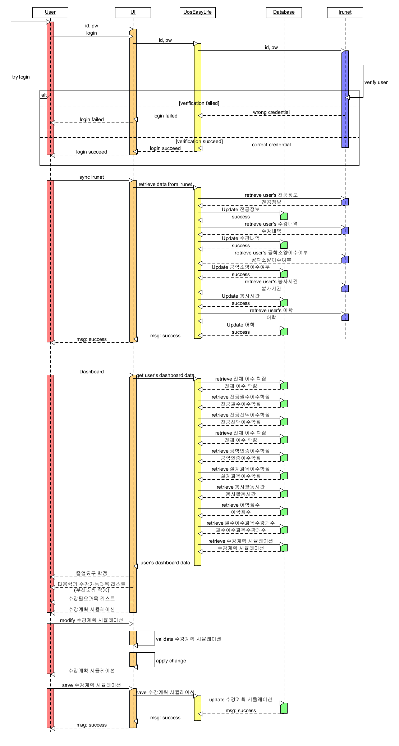
4. Archived Diagram: Sequence Diagram

